Slide 1
FAMILY FINANCES
Dr. Juan E Gonzalez

Slide 2
Money and Its Function
Money is not our God, it’s not our provider, and it’s not where we place our trust. Money is the tool that helps us fulfill God's mission for our lives.

Slide 3
Financial stability plays a significant role in family happiness. In fact, money is one of the most common subjects of heated arguments in the home and, consequently, contributes significantly to divorce rates.

Slide 4
At times, disagreements stem not from a lack or abundance of money, but from the way it is managed. Our plans and intentions may be good, but the reality can be a disaster.

Slide 5
In this seminar, we aim to present biblical and practical principles that, if applied, will help us improve our finances—and, consequently, our family relationships.

Slide 6
We are going to talk about:
The importance of the family budget.
The collective commitment to family expenses.
The difference between expenses and investments.
Financial infidelity.
The danger of overextending the budget.

Slide 7
We will also discuss the dangers of debt, credit cards, and compulsive spending, as well as the devastating effects of losing control over one's finances.

Slide 8
The Family Budget
“Suppose one of you wants to build a tower. Won’t you first sit down and estimate the cost to see if you have enough money to complete it? For if you lay the foundation and are not able to finish it, everyone who sees it will ridicule you, saying, ‘This person began to build and wasn’t able to finish.” Luke 14:28-30.

Slide 9
The advantages of a budget
It helps people be responsible,
To fulfill their financial obligations,
To avoid falling into undue debt,
To save for emergencies,
To invest and grow their money,
And to help those in need.

Slide 10
Danger of Overextending the Budget
Budget overextension occurs when you take on more debt than you can afford to repay. For example, when housing payments consume 40% or more of your income, other areas of your budget suffer greatly.

Slide 11
“Many, very many, have not so educated themselves that they can not keep their expenditures within the limit of their income. They do not learn to adapt themselves to circumstances, and they borrow and borrow again and again, and become overwhelmed in debt, and consequently they become discouraged and disheartened.” CS 248.

Slide 12
We should be on our guard, and not allow ourselves to spend money upon that which is unnecessary, and simply for display. We should not permit ourselves to indulge tastes that lead us to pattern after the customs of the world, and rob the treasury of the Lord.— The Review and Herald, December 19, 1893.

Slide 13
Collective Family Commitment
The family must function as a team. Therefore, all its members—provided they have the capacity to do so—must contribute toward paying for household expenses. When this happens, the family is more united, stable, and happy.

Slide 14
The fairest and most realistic way to divide expenses in a multigenerational household is to distribute costs equitably, based on the members' ability to pay, rather than on what they consume or the expenses they incur.

Slide 15
Financial Infidelity
Financial infidelity, in a shared economy, occurs when one partner conceals decisions related to their personal finances. It is important to be on the same financial page and ensure that you maintain open and transparent communication.

Slide 16
For example, when one of the partners incurs in personal debts and conceals them from the other party, secretly siphons off assets for personal gain, or attempts to cover up significant financial problems.

Slide 17
Arguing with one's partner over money is a problem. But lying about it—and how it is spent—is equally problematic; it carries grave consequences. The act of lying to one's partner about these matters is detrimental to the marriage. The damage is severe enough to destroy it.

Slide 18
Debts
It is much easier to get into debt than to get out of it. The Apostle Paul was very wise when he said: “Let no debt remain outstanding, except the continuing debt to love one another, for whoever loves others has fulfilled the law.” Romans 13:8.

Slide 19
The decisions we make regarding the management of our money affect not only us, but also those around us, our family, friends, church, and can last forever.

Slide 20
Credicards
The philosophy behind these financial instruments is: spend now and pay later. It sounds nice and evokes a pleasant feeling, but frequently, the results are devastating for individuals and their families.

Slide 21
If you cannot control the urge to spend, it would be a good idea to get rid of your credit cards. The truth is that people spend more when using credit cards than when paying with cash.

Slide 22
Difference Between Expense and Investment
The fundamental difference between an expense and an investment is the return provided by the financial transaction. While an investment is expected to yield future gains, an expense involves using money to pay for a service or object that provides momentary satisfaction but depreciates over time.

Slide 23
Examples
A house is an investment because its value increases over time.
A car is an expense because its value declines over time.
The house appreciates; the car depreciates.
Wise advice: If the satisfaction outweighs the cost, it is worth it.

Slide 24
Invest your Money
The Parable of the Bags of Gold. Matthew 25:14-30.
“Well then, you should have put my money on deposit with the bankers, so that when I returned I would have received it back with interest.So take the bag of gold from him and give it to the one who has ten bags. 29 For whoever has will be given more, and they will have an abundance. Whoever does not have, even what they have will be taken from them.” Verse 27-29.

Slide 25
The Multiplicative Power of Compound Interest
On the website https://www.investor.gov/additional-resources/free-financial-planning-tools/compound-interest-calculator, you can clearly see how money multiplies using the following formula:
Initial Investment + Monthly Contribution × Number of Years × Interest Rate.
Example:
$1,000 + $200 × 40 × 9% = $842,327.29
The total investment will amount to $57,000.00, and that investment will grow to $842,327.29.

Slide 26
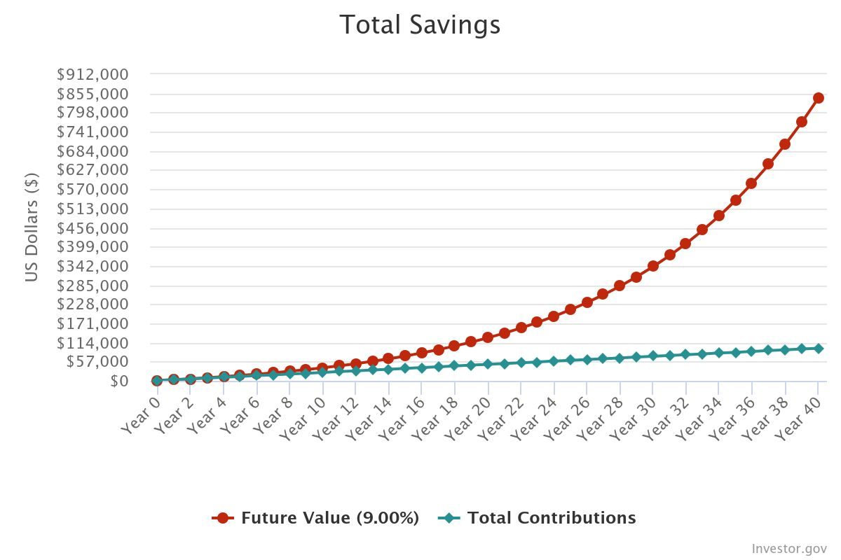

Slide 27
IRA
An Individual Retirement Account (IRA) provides tax incentives for individuals to make investments that can offer financial security for their retirement.

Slide 28
Traditional IRA
Traditional IRA accounts provide tax-deferred growth. This means that your money grows tax-free until you begin taking distributions, at which point your withdrawals are subject to taxation at your applicable income tax rate.

Slide 29
Roth IRA
Roth IRA accounts are attractive to those who can pay the taxes now to reap the reward of tax-free federal income later. The payoff comes when you withdraw your contributions and take home the full amount free of federal taxes, provided that at least five years have elapsed since your first contribution to the Roth IRA account and you are over age 59½.

Slide 30
401 (K)
Many employers offer incentives for employees to make contributions to their 401(k) plans by matching contributions up to a certain point. For example, some may contribute 50 cents for every dollar the employee contributes to the plan, up to a certain percentage of the employee's salary.

Slide 31
Your Legacy
Planning for your future is wise and should positively impact your life, your family, the community around you and future generations.
"A good person leaves an inheritance for their children’s children. ” (Proverbs 13:22) You will be remembered more for what you give than for what you possess.

Slide 32
David Ramsey say: “We make a living by what we receive, but we make a life by what we give... Giving liberates the giver's soul. You never walk away feeling bad. Whether through a tithe, a charitable contribution, or a gift to a friend in need, give away a portion of your money. It not only generates good feelings, but it creates joy. Remember, no one has ever become poor by giving.”

Slide 33
“You need to plant a seed in your own growth, and you can only do so by giving. I don’t fully understand what giving does for the human spirit, but I know very few well-balanced, happy, healthy, and wealthy people who do not give money.” David Ramsey

